Slide 1
The M6 Competition
Methodology and Lessons Learned
Colin Catlin

Slide 2
Brief M-series competition history
Not related to BMW cars, although that’s what Google will show
Started and still run by Spyros Makridakis, based in Crete
First in 1982, then 1993, 2000, 2020, 2021, and 2022
Easier to collect results now, and faster innovation
A placeholder for an M7 competition is already on their website
Generally a strong reputation in the forecasting world

Slide 3
M6 Background
Open to anyone, 163 teams on final leaderboard
Hosted by University of Nicosia, with various tech sponsors
$300,000 in total prizes
12 test submissions every 4 weeks, predicting 4 weeks ahead
About 40 hours from stock market close to submission deadline each submission Sunday at noon. Runtime is a constraint.
Forecasting 100 pre-designated Stocks/ETFs
https://mofc.unic.ac.cy/the-m6-competition/

Slide 4
Ten Official Hypotheses of the M6 Competition
The efficient market hypothesis will hold for the great majority of teams but this will not be the case for the top-performing ones.
Team rankings based on information ratios will be different from rankings based on portfolio returns or rankings based on the volatility of portfolio returns.
There will be a weak link between the ability of teams to accurately forecast individual rankings of assets and risk adjusted returns on investment. The magnitude of this link will increase in tandem with team rankings, on average. Additionally, team portfolios will in general be more concentrated and risky than can be theoretically justified given the accuracy of their forecasts.
Top performing teams in the investment challenge will build their portfolios using assets that they can forecast more accurately.
Teams will be measurably overconfident in the accuracy of their forecasts, on average. Namely, forecasts will be less dispersed and have smaller variance than observed in the data.
There will be a small group of participants that clearly outperform the average both in terms of forecast accuracy and portfolio returns.
Averaging forecast rankings (investment weights) across all teams for each asset will yield rankings (weights) that outperform those of the majority of the teams, except in cases where the very worst teams are removed from the average.
Teams that employ consistent strategies throughout the competition will perform better than those that change their strategies significantly from one submission point to another.
Submissions based on pure judgment or that rely heavily on judgment will perform worse than those based on data-driven methods, on average.
The top-performing teams in the forecasting challenge will employ more sophisticated methods compared to the top-performing teams in the investment challenge.

Slide 5
My Personal Hypothesis
That I will do well in the forecasting division compared to others, but that my model won’t have enough information from just the time series to beat the market

Slide 6
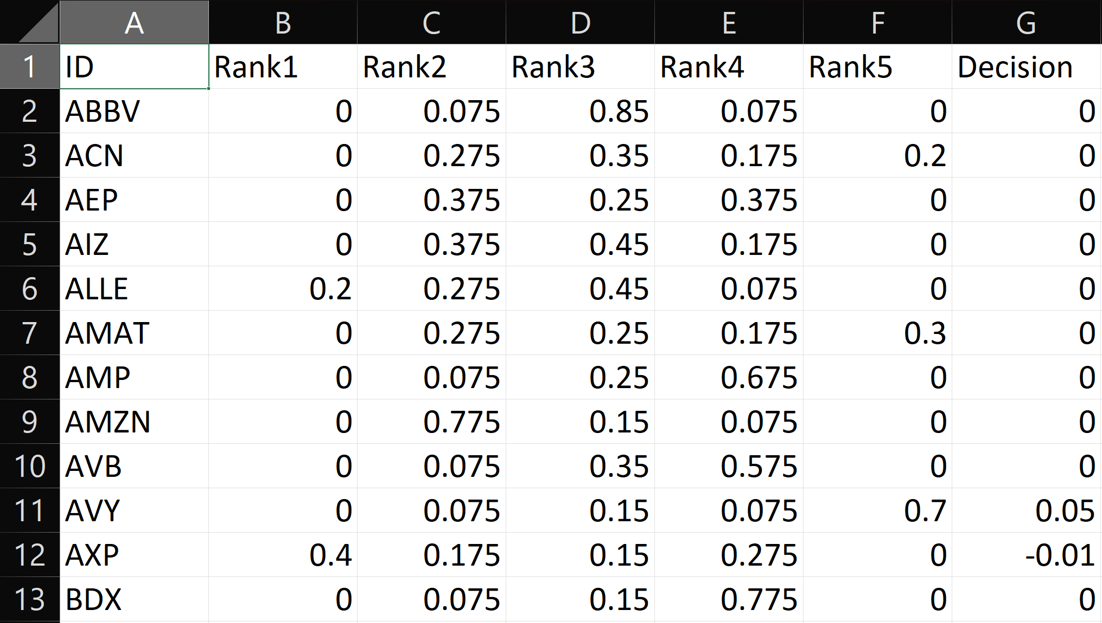
The M6 Submission Format

Slide 7
Forecasting Category
Submit the probability a stock’s returns will fall within a certain quantile (Rank 1 -5). Ie. Top 20%, 20th-40th%... Essentially into groups of 1st, 2nd, 3rd, 4th, and 5th place.
Utilizes the ranked probability score (RPS) to evaluate ranks
RPS favors closeness, so predicting someone will finish 1st and they finish 2nd is much better than predicting they are first and they finish last.
https://syllepsis.live/2022/01/22/ranked-probability-score-in-python/

Slide 8
Problems of the RPS Metric
Choosing a good evaluation metric is hard, especially for forecasting
Almost all teams fall within the same narrow range of scores from 0.155 to 0.165, and no correlation with investment performance (or indeed with other metrics like SMAPE in my experience)
“Most stocks follow the market most of the time”
Actual variance between the stocks that determines the ranking is often very small, and effectively random
Requires predicting all stocks with high accuracy.
The fact that my forecasts were good enough to beat the market but failed to do well in the RPS should be pretty indicative

Slide 9
Decision Category
Can invest a total of an absolute “1”, so each decision is effectively a % of your portfolio in that stock.
Amounts can be negative (‘short’)
Challenge is going to be taking forecasts (with probabilistic bounds) and turning them into confident decisions.

Slide 10
My Process
Source daily stock data (yfinance)
Write up code for the competition’s evaluation metrics
Come up with ways of converting AutoTS outputs to competition outputs
Write up a loop to test different AutoTS params + different forecast to investment decision methodologies
Powerful computing hardware was critical to being able to run and test so many parameters and models
Write up submission script using best test parameters, this using an evolving template building on each previous submission.
Throughout competition, following AutoTS updates, rerun test loop and do minor tuning updates. Major activity Jan-Feb ‘22, May-June ‘22, Sept-Oct ’22

Slide 11
Forecasting Methodology
5 years of history used. Converted to 4 week frequency as I only care about accuracy of the destination.
A constant was using AutoTS. Actual params/models changed monthly and I made lots of updates to AutoTS over the year.
Provided a few external regressors but they weren’t often used.
Used an evolving template, sometimes including ensembles
Multivariate models (shared information among series) were usually a bit better than univariate models for this data.
‘Directional’ accuracy is a concept I developed specifically as a result of this competition

Slide 12
Directional Accuracy
Directional Weighted Absolute Error (DWAE):
If forecast and actuals moved in the same direction (growth or decline) relative to last data point, then use MAE, else use (RMSE + 1)
Origin Directional Accuracy (ODA):
% of points that move in same direction (growth or decline) relative to last known historic data point

Slide 13
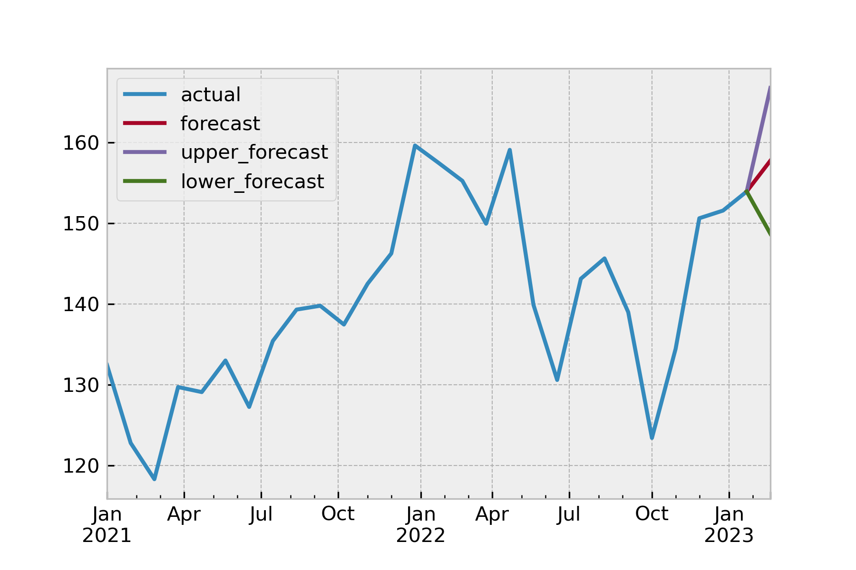

Slide 14
Forecast to Decision
Need to combine price outputs into a decision.
Testing showed probabilistic forecasts to be useful, to remove stocks where direction is uncertain.
Convert forecasted price into forecasted % return
“Hinge” – average of upper and lower returns (tends to be near zero for higher uncertainty forecasts as chance of up/down is near even)
“Agreement” – only invest where all forecasts agree on direction
Round toward zero

Slide 15
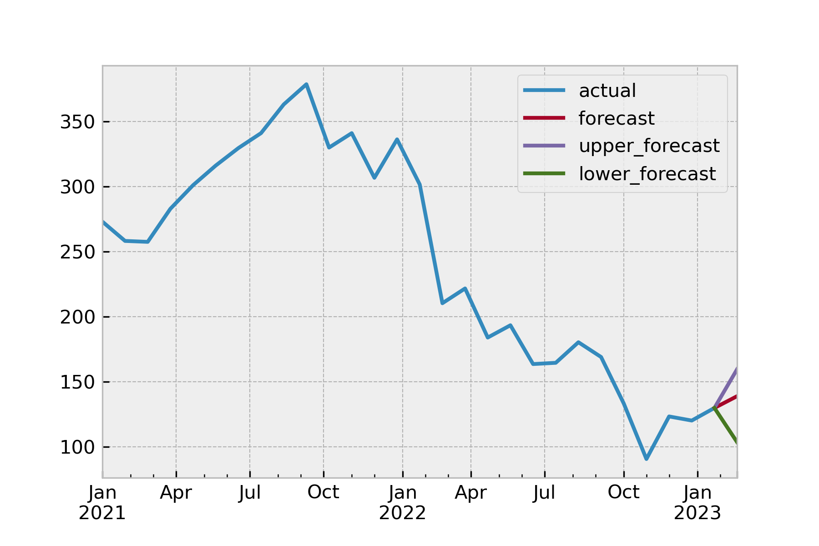

Slide 16
Conclusion
Time series forecasting alone with limited external information are indeed capable of strong performance in complex scenarios, here beating the stock market.
Taking probabilistic forecasts to actionable decisions is challenging, but can be successful, if perhaps not very ‘explainable’.
Multivariate models were usually better and horizontal ensembling was not necessary (all series here are similar).
Importance of choosing good evaluation metrics.
AutoTS is amazingly awesome. AutoML in general should not be ignored, although it isn’t always required.

Slide 17
https://syllepsis.live/2023/04/03/winning-the-m6-financial-forecasting-decision-category/

